Slide 1
Analysis of Route Concepts
An approach to measuring the effectiveness of different route combinations during the 2020 NFL Season
Joe Andruzzi

Slide 2
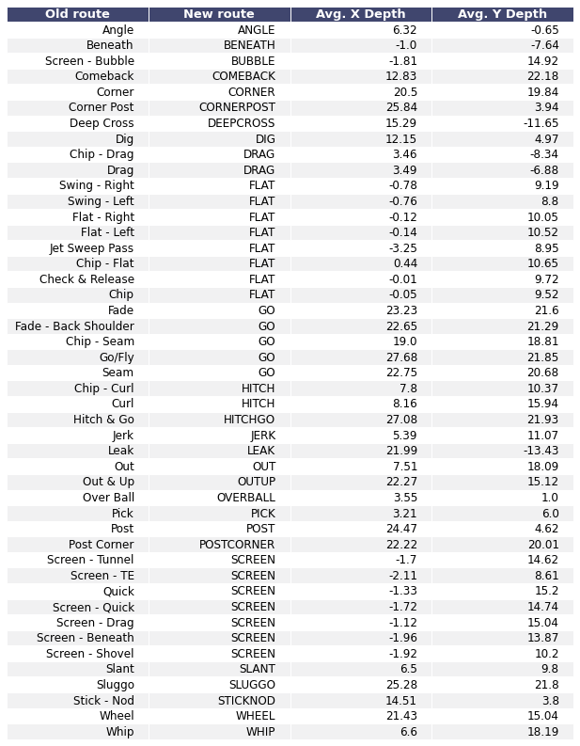
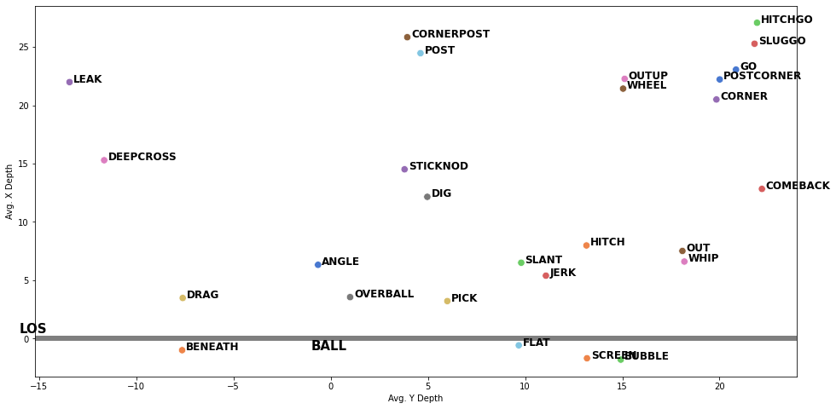
Creating Expected X & Y Depth Target Coordinates
Using 2018 Big Data Bowl tracking data, we can use a model to create expected X and Y target locations for each route – estimates are based on position, player alignment, and other features.
This information will only be used to help include backside routes when evaluating all route combinations – otherwise this process would need to be done manually.
Eligible combinations will include all routes that are on the same side as the targeted player, or any backside route that has an expected location within 20 yards of the targeted route. (20 yards - same assumption made by Sterken’s 2018 RouteNet paper)
This is the POV for the right side of the formation – Expected Coordinates are subject to change based on position, alignment, and other various factors

Slide 3
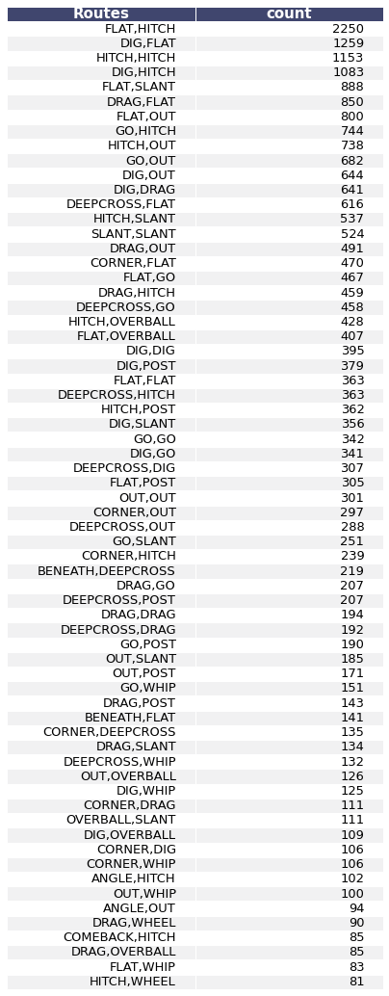
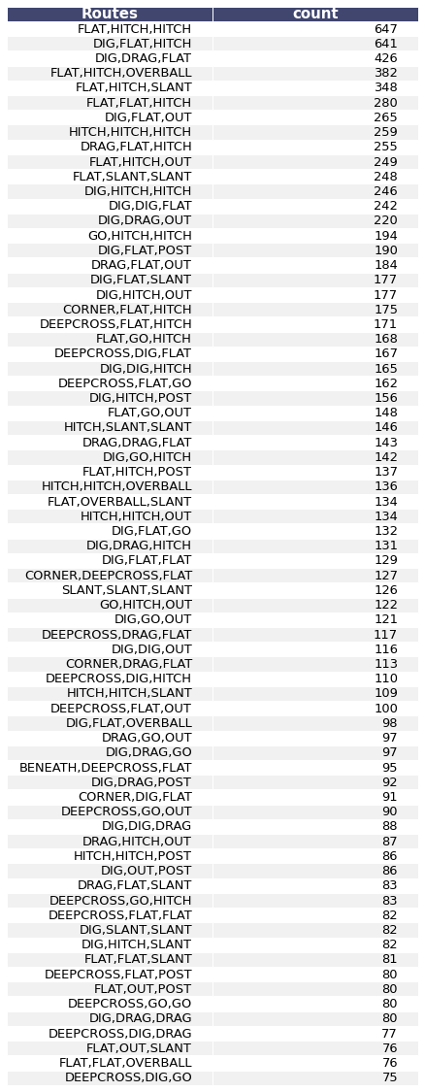
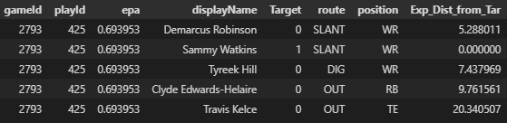

Top Two-Man Concepts
Top Three-Man Concepts
Data Preparation
Removed Observations
Play contains Spike/Kneel/Throw away/Screen
Play contains Sack or receiver fumble (Skews EPA)
Play containing receiver positions other than: WR, TE, RB/FB
Trick plays – Flea Flicker, Other, RB/WR Pass, WR Reverse Pass, Double Reverse Pass
Unique/Rare route combinations where sample size is < 80 for Two-Man Concepts and < 75 for Three-Man Concepts
Removed Routes
“Run Fakes” – play labeled play-action, and route was removed from dataset
“Blocking” – route was removed from dataset
Data Transformation
An example of a melted frame, isolating all potential two-man concepts
The data is “melted” to focus on all potential route combinations for each play – I believe this is the best method to isolate certain route pairs/trios, even in complex formations.
Potential interaction routes will be any route that begins on the same side of the targeted receiver, or any backside route that has an expected location within 20 yards of the receiver.

Slide 4
Modeling & Determining Value
2 Models
Model: Catboost
A single metric evaluation system to identify optimal route combinations is not sufficient – Instead, 2 metrics will be used: EPA for “High upside” & First down/Yards-to-go success for “High Reliability”.
Features Used for EPA & Success Models
2 Models will be used – One to predict “EPA”, and the other to predict “Success”
Two-Man Concepts
Coverage Type
Target Route
Down
Distance Bin (8+, 8-3, <3)
QB Rollout (1/0)
Shotgun (1/0)
Play Action (1/0)
Target Location #
Redzone (1/0)
Complementary Route
Complementary Route Position
Complementary Route on Target Side (1/0)
Complementary Route Location #
Routes Group (Target Route + Complementary Route)
Positions Group (Target Position + Complementary Route Position)
Three-Man Concepts
Coverage Type
Target Route
Down
Distance Bin (8+, 8-3, <3)
QB Rollout (1/0)
Shotgun (1/0)
Play Action (1/0)
Target Location #
Redzone (1/0)
Complementary Route 1
Complementary Route Position 1
Complementary Route 1 on Target Side (1/0)
Complementary Route1 Location #
Complementary Route 2
Complementary Route Position 2
Complementary Route 2 on Target Side (1/0)
Complementary Route 2 Location #
Routes Group (Target Route + Comp Route 1 + Comp Route 2)
Positions Group (Target Pos + Comp Route1 Pos + + Comp Route 2 Pos)
“Success” = When Actual Yards Gained >= Yards-to-go
“EPA” = Sports Info Solutions Expected Points Added metric
Scenarios
Model 1: x_EPA
Model 2: x_Success
Scenario 1: 1st Down & 8+
“Seeking High Upside”
Model 1: Scaled(x_EPA)*(.75)
Model 2: Scaled(x_Success)*(.25)
Scenario 2: 3rd Down & 3 or less
“Seeking The Sticks”
Model 1: Scaled(x_EPA)*(.25)
Model 2: Scaled(x_Success)*(.75)
Using the 2 expected values, we will run 2 different scenarios on each defensive coverage to show how different combinations provide value when the situation changes. We will weigh EPA and Success differently depending on the situation.
Determining Value
To determine a route combinations value, the assumption will be that both routes in two-man concepts and all three routes in three-man concepts will have quality value across the board – when the 1st read breaks down, it is assumed that the 2nd read and/or 3rd read will also have a high value, thus making the route combination as foolproof as possible.
Brute Force – Optimal Position Groups, Alignment and more
After we train the models, we will attempt to determine what other factors can improve route combination effectiveness by going through thousands of different scenarios - changing position groups, adding play-action, changing receiver alignment and much more.

Slide 5
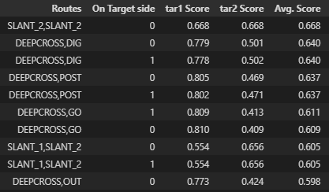
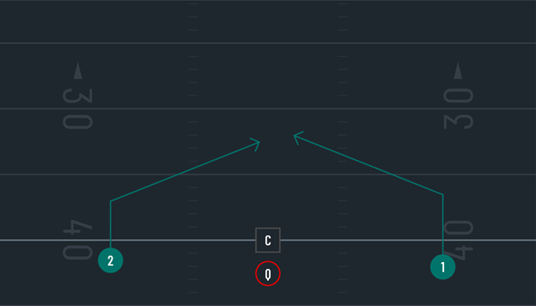
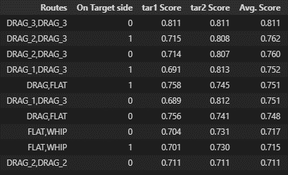
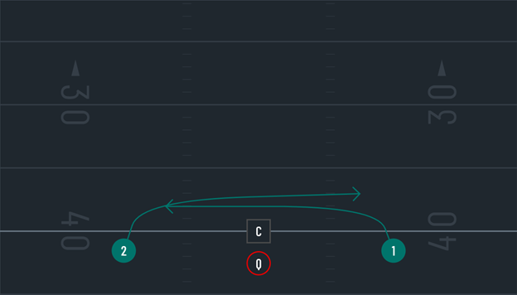


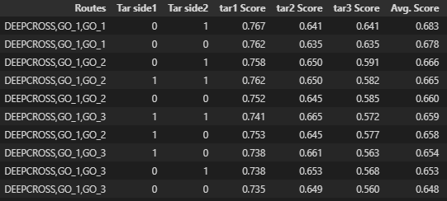
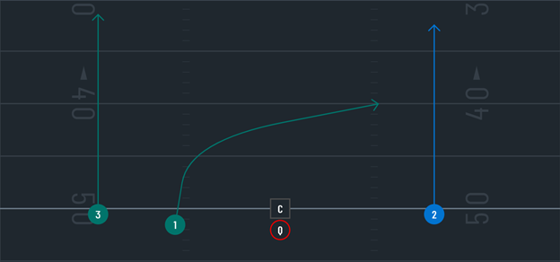
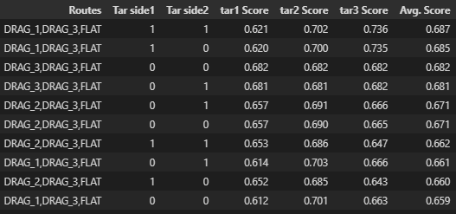
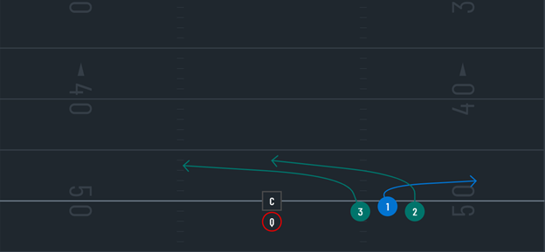


Cover 0
Scenario 1: “Seeking High Upside”
Scenario 2: “Seeking The Sticks”
Top Two-Man Concepts
The Play
Top Two-Man Concepts
The Play
Analysis
The double slant is estimated to provide the highest average foolproof upside, however the Deep Cross + Dig coming from the backside may pose for higher upside on the Deep Cross.
Exploring other variables
Analysis
The drag route seems popular here, with a double drag coming from both sides as the optimal combination.
Exploring other variables
Top Three-Man Concepts
The Play
Top Three-Man Concepts
The Play
Analysis
The Deep Cross from the slot with different variations of double Go routes are optimal here. Having the double Go’s clear out, while hitting the Deepcross over the middle on most likely man-to-man coverage.
Exploring other variables
Analysis
Even in 3-man concepts, the drag rules in short yardage situations. The optimal solution includes double drag and a flat route all from the same side.
Exploring other variables

Slide 6
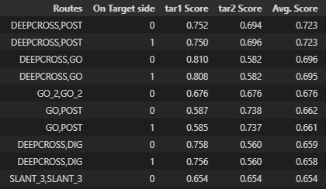
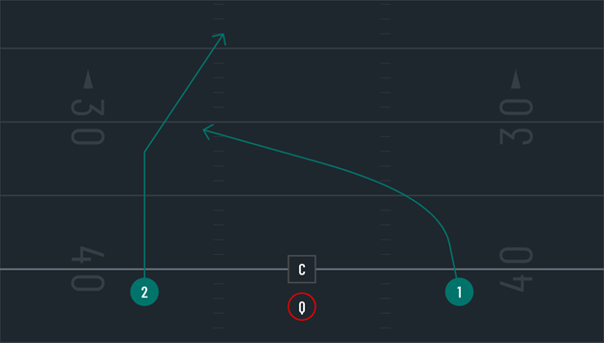
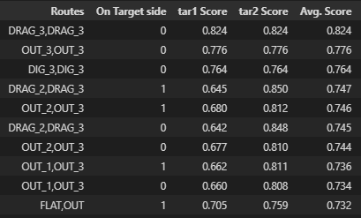


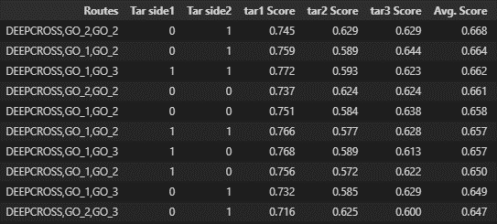
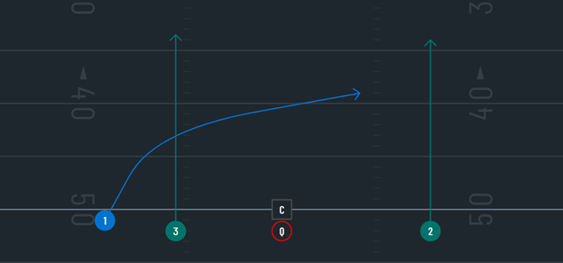
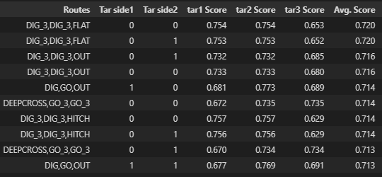
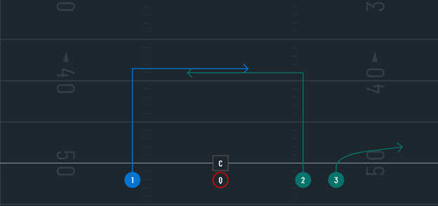


Cover 1
Scenario 1: “Seeking High Upside”
Scenario 2: “Seeking The Sticks”
Top Two-Man Concepts
The Play
Top Two-Man Concepts
The Play
Analysis
The Deep Cross + Post combination shows the highest upside here – The post will keep the single-high safety occupied while the Deepcross comes underneath.
Exploring other variables
Analysis
Just like in Cover 0, the double drag coming from each end will have defenders chasing – either Drag acting as a potential rub route as well.
Exploring other variables
Top Three-Man Concepts
The Play
Top Three-Man Concepts
The Play
Analysis
Deep Cross + double Go’s just like the optimal cover 0 routes – except with a slight variation by lining the Deep Cross on the outside.
Exploring other variables
Analysis
Wasn’t expect this one – but a double Dig coming from both directions and a Flat route as a safety valve.
Exploring other variables

Slide 7
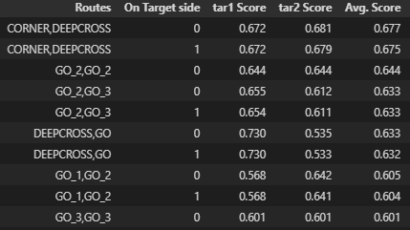
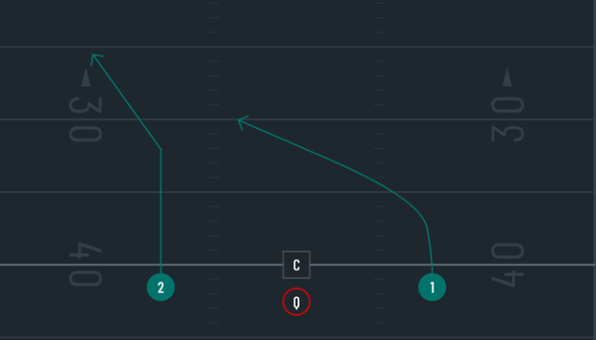
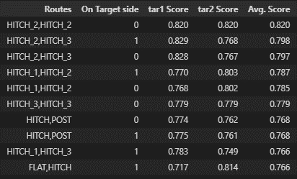
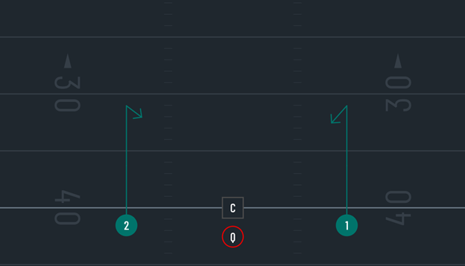


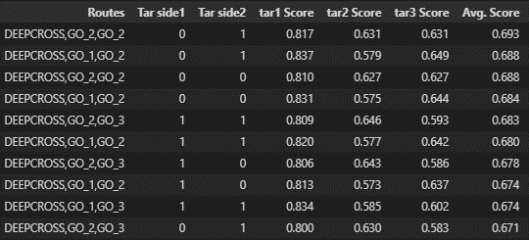
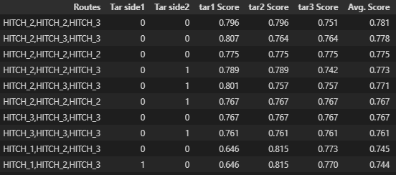
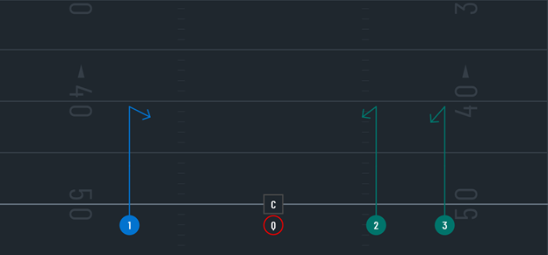


Cover 2
Scenario 1: “Seeking High Upside”
Scenario 2: “Seeking The Sticks”
Top Two-Man Concepts
The Play
Top Two-Man Concepts
The Play
Analysis
The Corner + Deep Cross should be a staple combination against Cover 2 – the target side safety must decide on the Corner or the Deepcross
Exploring other variables
Analysis
The double Hitch from opposite slots appear to be optimal.
Exploring other variables
Top Three-Man Concepts
The Play
Top Three-Man Concepts
The Play
Analysis
The Deep Cross + double Go’s like cover 1, using the outside receiver Deep Cross appears optimal.
Exploring other variables
Analysis
Just like in the 2-man concept, all Hitches appear to be the way to go.
Exploring other variables

Slide 8
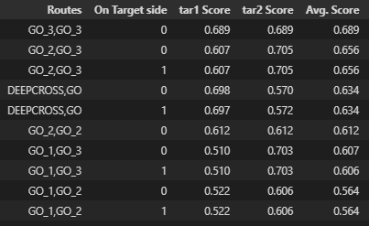
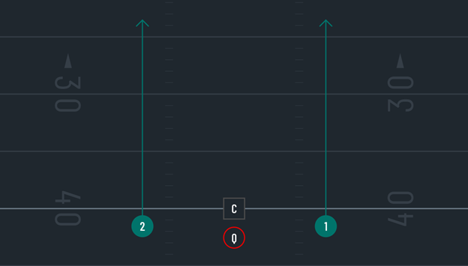
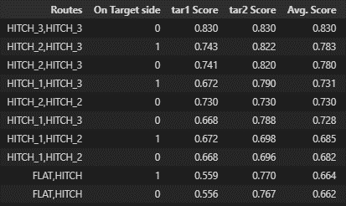



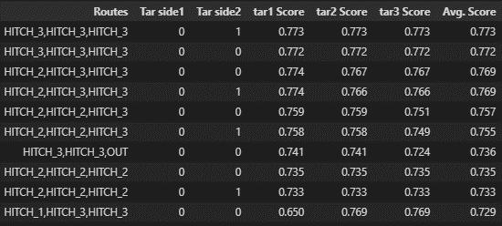


Cover 2 Man
Scenario 1: “Seeking High Upside”
Scenario 2: “Seeking The Sticks”
Top Two-Man Concepts
The Play
Top Two-Man Concepts
The Play
Analysis
The dual slot seam routes appear optimal here – even in different variations. The Deepcross + Go is a close second.
Exploring other variables
Analysis
The double Hitches again – find those open zones.
Exploring other variables
Top Three-Man Concepts
The Play
Top Three-Man Concepts
The Play
Analysis
The Deep Cross + double Go again – the Go routes will occupy both safeties and allow the Deepcross plenty of room to work with.
Exploring other variables
Analysis
All these Hitch routes from the slot being optimal for short yardage is interesting – would love more data to explore this further.
Exploring other variables

Slide 9
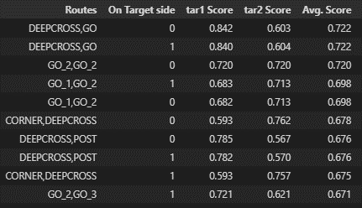
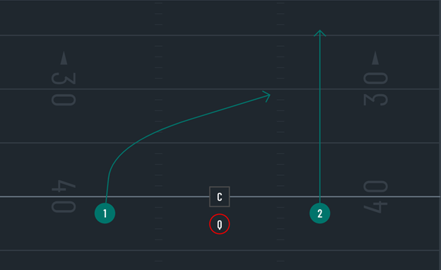
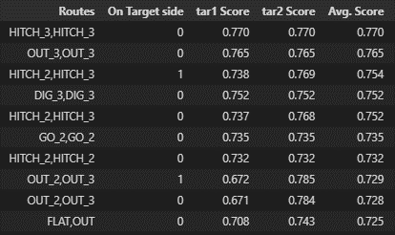


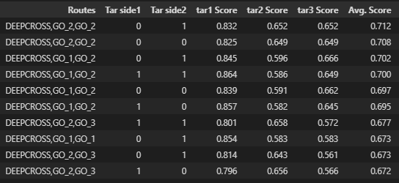
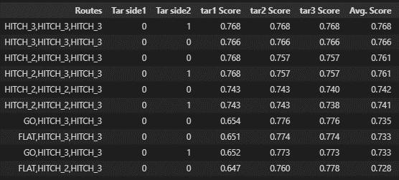


Cover 3 + Tampa 2
Scenario 1: “Seeking High Upside”
Scenario 2: “Seeking The Sticks”
Top Two-Man Concepts
The Play
Top Two-Man Concepts
The Play
Analysis
Deep Cross + Go must be the way to go. Looks like it could be open right in-between the middle safety and the safety on the target side.
Exploring other variables
Analysis
The dual Hitch slot is optimal again, just as Cover 2.
Exploring other variables
Top Three-Man Concepts
The Play
Top Three-Man Concepts
The Play
Analysis
Deep Cross + double Go, what’s new?
Exploring other variables
Analysis
All Hitches to get the first down – I see a common theme here.
Exploring other variables

Slide 10
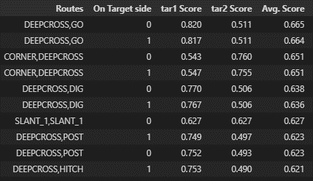
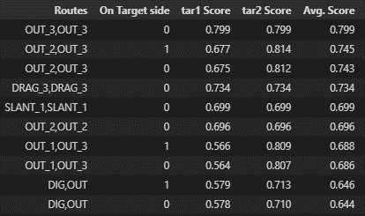
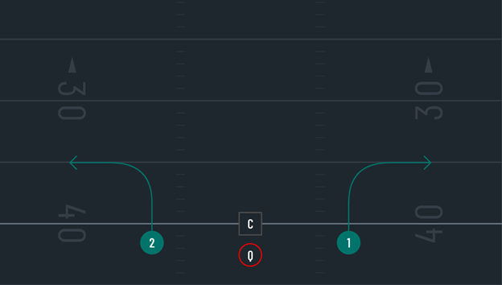


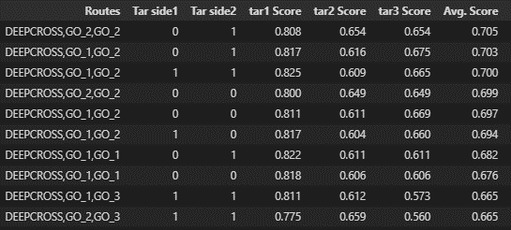
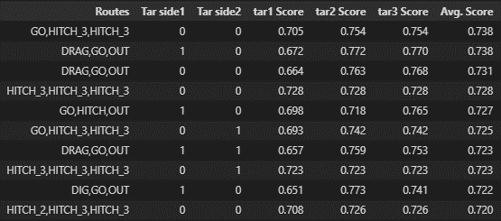
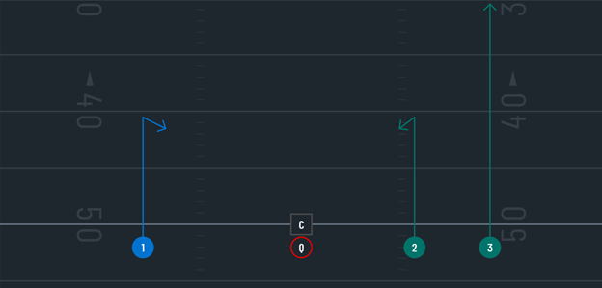


Cover 4
Scenario 1: “Seeking High Upside”
Scenario 2: “Seeking The Sticks”
Top Two-Man Concepts
The Play
Top Two-Man Concepts
The Play
Analysis
Deep Cross + Go – you could have guessed it.
Exploring other variables
Analysis
If you’re lucky enough to have a defense run Cover 4 on 3rd and short - Dual Out routes from opposite slots appear optimal in many variations – with the double drag close by.
Exploring other variables
Top Three-Man Concepts
The Play
Top Three-Man Concepts
The Play
Analysis
Just crown the Deep Cross + double Go combination – appears to be optimal in many different scenarios.
Exploring other variables
Analysis
Go, Hitch, Hitch – Interesting wrinkle compared to other short-yardage 3-man concepts.
Exploring other variables

Slide 11
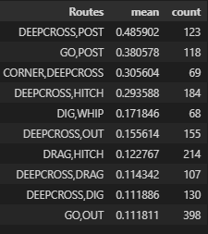
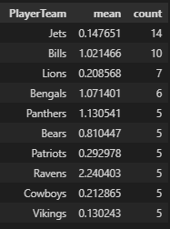
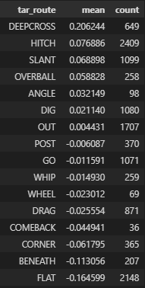
The Deep Cross
You saw it, the Deep Cross showed up as the optimal target in many variations – against all defensive coverages.
The Deep Cross - EPOE
Top EPOE 2-Man concepts
Deep Cross + Post
If you’re still not sold – we can use a simple metric called EPAOE to further confirm that the Deep Cross is the most effective route.
EPAOE = EPA on the play – (Average EPA the offensive team generally produces)
Who’s running this foolproof optimal 2-man concept? Let’s look at the top 10 teams.
Compared to all targeted routes on 2-man concepts – the Deep Cross had the highest EPAOE/play by nearly .13 over the next closest!
The Deep Cross + Post had shown to be the best Cover 1 beater in my model, now we confirm its effectiveness with the highest EPAOE per play.
The Deep Cross route appears in 6/10 of the top EPAOE combinations.
What’re the odds that the top 10 teams that run this concept all have a positive EPAOE/play? What if I told you the Jets are on the forefront of this combination?
With a sample size of 123, I would love to see that number larger, but this stands out given the data we have.

Slide 12
Findings
“Seeking High Upside”
Nearly all optimal “Seeking High Upside” combinations incorporated a Deep Cross, and then complimented it with a deep route - Post, Go or Corner. Intuitively, the success of this play makes sense, as it forces the target side safety to make a choice – and he will most likely take on the deeper route, leaving the Deep Cross open. The jury is still out for the Deep Cross as we wait for a larger sample size, but preliminary results appear positive.
“Seeking The Sticks”
The optimal short yardage play appeared to be running dual opposing Drag routes from the slot in obvious man-to-man situations like Cover 0 or Cover 1. The dual Drag make sense, as crossing routes are very popular against man-to-man. Another optimal combination would be running dual Hitches from opposing slots. Running Hitches from the slot is a great way to find open spaces in the middle of the field – a very simple, yet effective concept.

Slide 13
Limitations & Future work
Limitations & Future Work
The obvious limitation is not enough data – small sample sizes will always be a challenge. As the sample increases, the picture will become clearer.
Tracking data – having the ability to use spatial data throughout the play would vastly improve this research. Evaluating route combinations based on spacing and separation would be optimal.
Time – Increased research time will improve the quality of work, perhaps 2-3 months as opposed to 1 month. Combinatorial analysis is a daunting task, especially with so many confounding variables.

Slide 14
Sources
Sources
http://breakdownsports.blogspot.com/p/football-fundamentals-offense.html
https://www.kaggle.com/c/nfl-big-data-bowl-2021/data
https://operations.nfl.com/media/3671/big-data-bowl-sterken.pdf
https://www.tacklefootballplaymaker.com/app/

